Slide 1
The Battle of the Neighbourhoods

Slide 2
The purpose of this Project is to help people in exploring better facilities in & around their neighborhoods. It will help them in making smart and efficient decisions when selecting their preferred neighborhood out of all the neighborhoods in Scarborough, Toronto.
Many people are migrating to Scarborough, Toronto and require a lot of research to find housing prices in their range and good schools for their children. This project will help such people.
This Project aims to create an analysis of features for people migrating to Scarborough to search best neighborhoods by comparing neighborhoods with each other. The features include median housing prices and schools according to ratings, crime rates of that area, road
Introduction
connectivity, weather conditions, management for emergency, water resources both fresh and wastewater and excrement conveyed in sewers and recreational facilities.
It will help people to get awareness of the area and neighborhood before moving to a new city, state, country or place for their work or to start a new fresh life.

Slide 3
Data Link: https://en.wikipedia.org/wiki/List_of_postal_codes_of_Canada:_M
I have used Scarborough dataset which we scrapped from Wikipedia in Week
Dataset consists of latitude and longitude, zip codes.
We will need data about different venues in different neighborhoods of that specific borough. In order to gain that information we will use "Foursquare" locational information. Foursquare is a location data provider with information about all manner of venues and events within an area of interest. Such information includes venue names, locations, menus and even photos. As such, the foursquare location platform will be used as the sole data source since all the stated required information can be obtained through the API.
After finding the list of neighborhoods, we then connect to the Foursquare API to gather information about venues inside each and every neighborhood. For each neighborhood, we have chosen the radius to be 100 meter.
The data retrieved from Foursquare contained information of venues within a specified distance of the longitude and latitude of the postcodes. The information obtained per venue as follow
Neighborhood
Neighborhood Latitude
Neighborhood Longitude
Venue
Name of the venue e.g. the name of a store or restaurant
Venue Latitude
Venue Longitude
Venue Category
Data Used

Slide 4
To compare the similarities of the neighborhoods, I
decided to explore neighborhoods, segment them, and
Methodology- K- Means Clustering
group them into clusters to find similar neighborhoods in a big city like New York and Toronto. To be able to do that, we need to cluster data which is a form of unsupervised machine learning: k-means clustering algorithm.

Slide 5
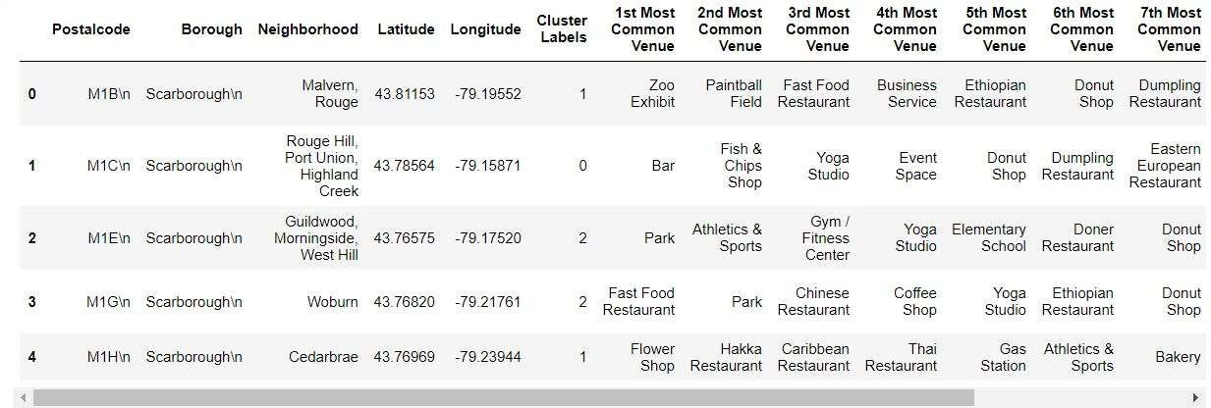
K-Means Clustering- Most Common Venues

Slide 6
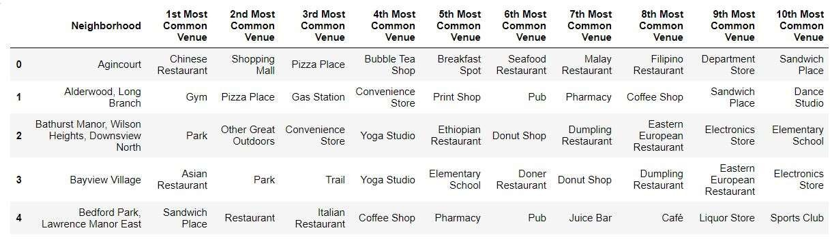
Most common venues near neighborhoods

Slide 7
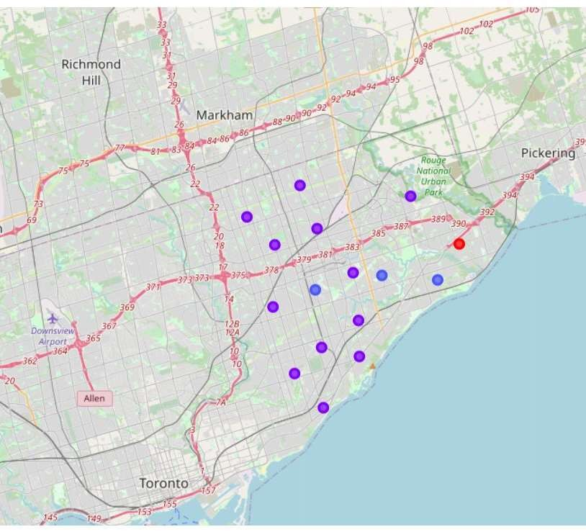
Results- Clusters in Scarborough

Slide 8
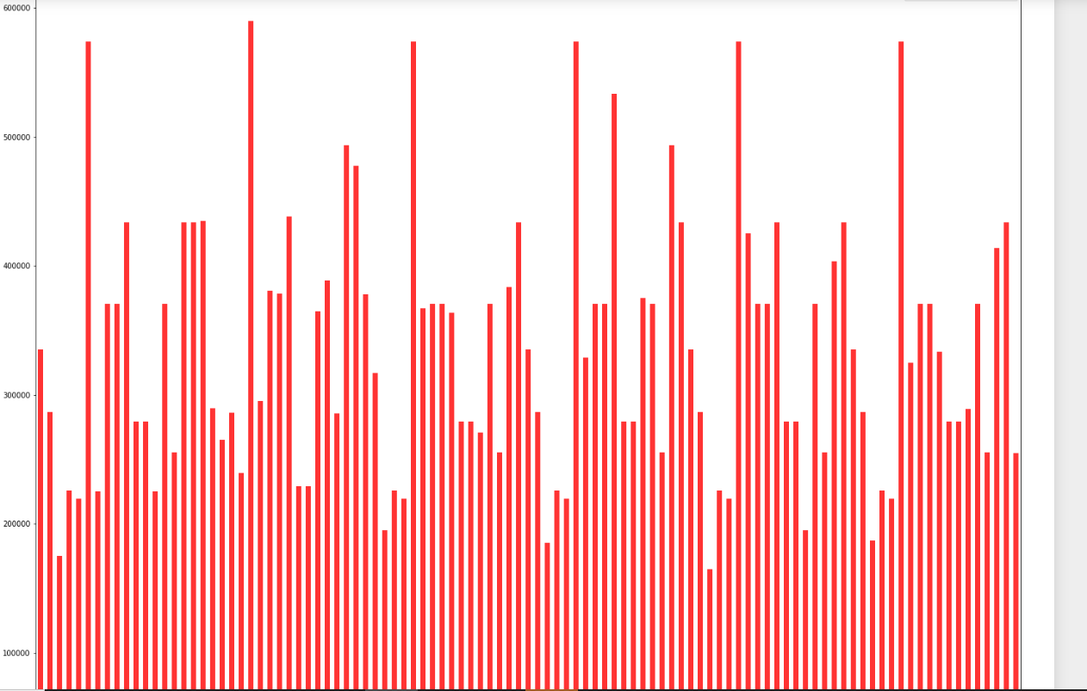
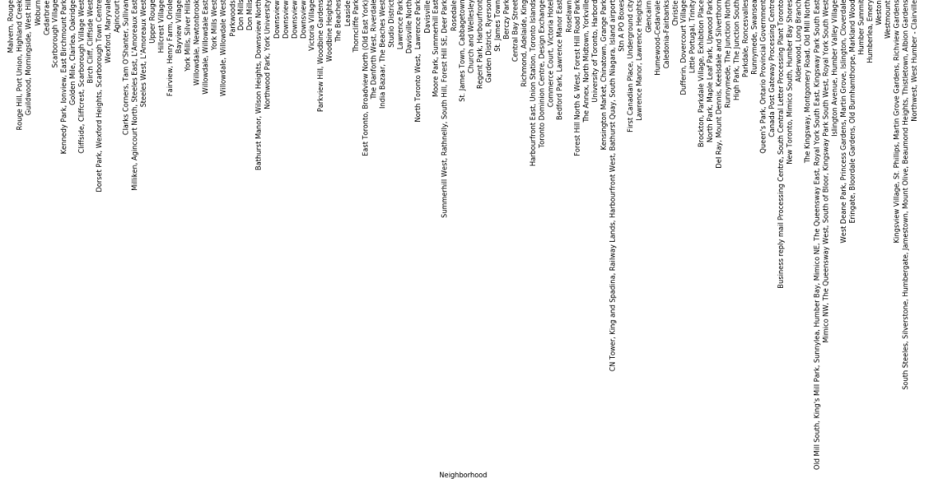
Results-
Average Housing Price by Clusters

Slide 9
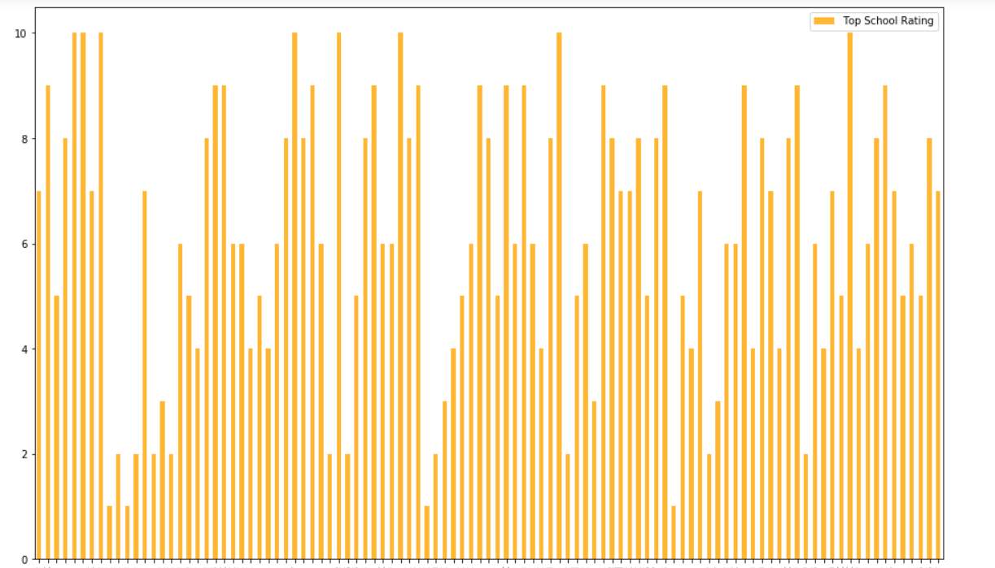
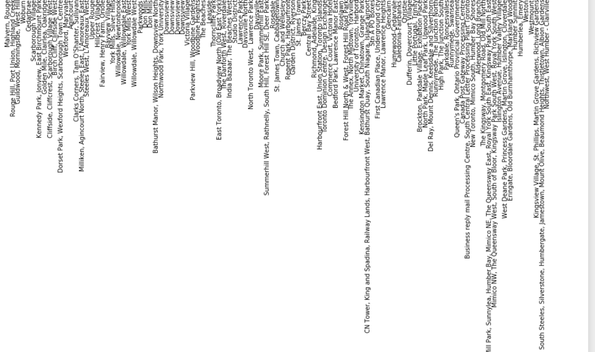
Results-
School Rsatings by Clusters

Slide 10
Thank you

